Slide 1
Pointers, Dynamic Memory Allocation, and Built-in Arrays
CPE010 – Data Structures and Algorithms

Slide 2
Intended Learning Outcomes:
After this module, the student should be able to:
Implement static and dynamic memory allocation
Create dynamically allocated objects using pointers and arrays
Solve programming problems using dynamic memory allocation, arrays and pointers

Slide 3
“Normal” Variable declarations
Normal variable instantiation automatically assigned a free memory address to a variable and stores that value in that memory address.
int x = 10;
x represents an alias for the memory address that holds the value 10.
When compiled, the variable name gets translated to it’s appropriate memory address.

Slide 4
Reference Operator (&)
The reference operator (&) is used to retrieve the memory address assigned to a variable
int x = 10;
cout << x; // prints value 10
cout << &x; // prints the memory address of x
We use the reference operator when using function / method parameter passing by reference.

Slide 5
Dereference Operator (*)
The dereference operator (*) allows you to access the value at a particular memory address.
int x = | 10;
cout << | x; // prints value 10
cout << | &x; // prints the memory | address | of | x
cout << | *&x; // prints the value | 10
example: variables.cpp

Slide 6
Pointers
A Pointer is a variable that contains the memory address of another location in memory that contains information.
0x0234
0x1234
0x1234
10
Pointer
Pointee

Slide 7
Pointer Declaration
To declare a pointer, you need to specify the variable type of the pointee and provide the asterisk between the data type and the name.
int *iPtr; double *dPtr;
It is best practice to declare pointers on their own lines.
It is also best practice to define the function return type as a pointer with the asterisks next to the data type, not the function name.
example: pointers.cpp

Slide 8
Pointer Assignment
Remember that pointers only hold a memory address. When we assign a value to a pointer, the value must be a memory address.
Draw the memory diagram for the following:
int value = 5; int *ptr = &value;
example: pointers2.cpp

Slide 9
nullptr
nullptr - null pointer keyword is used to indicate a pointer points to nothing.
A pointer assigned to nullptr is said to be null.
0x0234
0x0
Pointer
example: nullptr.cpp

Slide 10
Dynamic Memory
In this class, up until this point, we have only been concerned with data / memory that has been allocated on the stack.
With Dynamic Memory Allocation memory is allocated during runtime.
Dynamic Memory allocation uses the Heap.

Slide 11
C++ Memory
•
4 Main Memory Parts
Memory
•
•
•
•
Code
Static (Global) Variables / Data Stack
Heap
Stack
Heap
Static (Global)
Code
•
Heap and Stack vary dynamically
•
Code and Static/Global use is fixed
•
Code is read-only

Slide 12
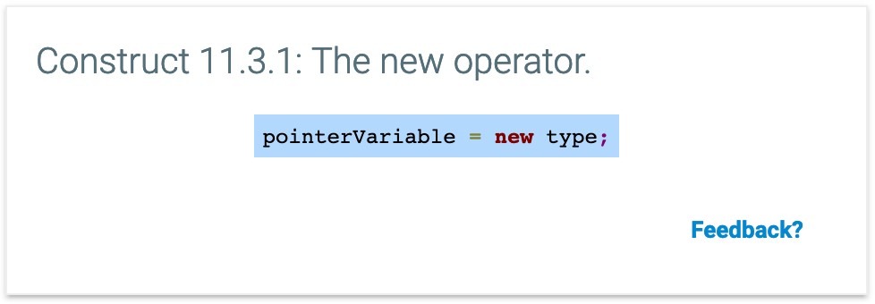
The new keyword
new: used for allocating memory (dynamic memory allocation)
The new operator allocates memory during runtime and is persisted independently of any particular function.
When we use the new keyword. The memory for that data is allocated on the heap.

Slide 13
Memory Diagram Exercise
Draw the memory diagram for the following:
1. | int | *ptr | = | nullptr;
2. | int int | value *ptr | = = | 10; &value;
3. | int | *ptr | = | new int;
4. | int | *ptr | = | new int(10);

Slide 14
Implement Swap with pointers
Lets implement swap using pointers. Here is how we implement swap with normal variables:
void swap(int &x, int &y) { int temp = x;
x = y;
y = temp;
}

Slide 15
Arrays
Arrays - Built in arrays in C++ are built using pointers!
int array[] = {1, 2, 3, 4};
The above actually creates a pointer called array that we can use to access elements inside the array.
The compiler knows that the [ ] syntax indicates an array of integer values.

Slide 16
Arrays
One of the only differences in arrays declared with [ ] or using pointers is that we can reassign pointers and not arrays.
Arrays are always declared const when using [ ] notation.
int array[] = {1, 2, 3, 4};
int * ptrArray = {1, 2, 3, 4}; array = ptrArray; // compiler error ptrArray = array; // ok

Slide 17
Dynamically Allocated Arrays
We can also dynamically allocate arrays
int *array = new int[10];
We can access arrays on the heap, the same way as before:
array[index];
However initialization is different:
int *array = {1,2,3,4}; // error

Slide 18
The delete operator
The delete operator does the opposite of the new operator.
This tells the OS to de-allocate or free up the memory block that is pointed to by the
delete ptr;
A general rule of thumb is for every new operator, there must be a delete operation.

Slide 19
delete operator more…
Memory Leak - a memory leak occurs when a programmer forgets to de-allocate memory that is pointed to by a pointer, then deletes the pointer or re-assigns the pointer to a new value.
Common Mistakes:
allocating memory in a loop and calling delete on the pointer outside of the loop.
not deleting data within an object that is dynamically allocated

Slide 20
delete[ ] operator
When dynamically allocating array’s, we use the delete[ ]
operator to indicate that we are freeing a block of memory.
int *array = new int[5];
delete[] array;

Slide 21
Pointers with Objects/Classes
It is very common that we use pointers and the new
keyword to create objects.
Student *a = new Student;
When the program executes this line, we first allocate the space for Student on the heap, then we call the Student default constructor.
We can also use other overloaded constructers for a class during initialization:
Student | *a | = | new | Student;
Student | *a | = | new | Student("Erik");

Slide 22
Member Access Operator
Accessing data members of a class can be done like the following:
Student *a = new Student; (*a).data_member; (*a).function();
However, with C++ and classes, we can use the member access operator (->) as an alternative (and easier) way of accessing data members or functions of a class.
a->data_member; a->function();

Slide 23
Destructors
A destructor is a member function that is called which destructs or deletes an object.
Employee::~Employee()
{
/* Clean up data */
}
Destructors are called when:
A function ends
The program ends
A block containing local variables end
A delete operator is called
A class only has one destructor

Slide 24
Copy Constructor
A copy constructor is used for a class to make a copy of an existing instance.
We use constants when we want to customize or tell the program how to copy an object when we pass by value.
*Remember: Pass by value creates a copy of the data and performs any operations on that copy in the function.
Copy Constructors are implicitly defined by the compiler if you do not define one and performs a member-wise copy of the source object.

Slide 25
Copy Constructor
It is important that we declare a copy constructor by passing in the class we want to copy as const.
MyClass::MyClass(const MyClass &copyClass) {
...
}
The most common use for the copy constructor is when the class has raw pointers as member variables and we need to make a deep copy of the data.

Slide 26
Deep vs Shallow copy
Deep Copy - a complete full copy of all data members of a class, including dynamically allocated memory.
Shallow Copy - a member-wise copy where we only copy the data members and NOT any dynamically allocated memory.
Your computer performs a shallow copy by default if no copy constructor is provided.

Slide 27
Copy Assignment Operator
Often times we want to copy one object to another using the assignment operator.
The program will implicitly create a copy assignment operator for you and do a member-wise copy.
But again we want to do a deep copy with an objects dynamically allocated data.
MyClass& Myclass::operator=(const MyClass& copy) {
}

Slide 28
Rule of Three
If you have to define one of the following as a programmer, then it is a good practice to define all of them.
- Destructor
Copy Constructor
Copy Assignment Operator
These are often known as the “big three”

